Slide 1



Greenify
Ignis Code
We want a world where everyone sorts waste properly, and nothing goes to waste.
Let’s make Earth clean and green —
Let’s Greenify it!
greenify@gmail.com

Slide 2
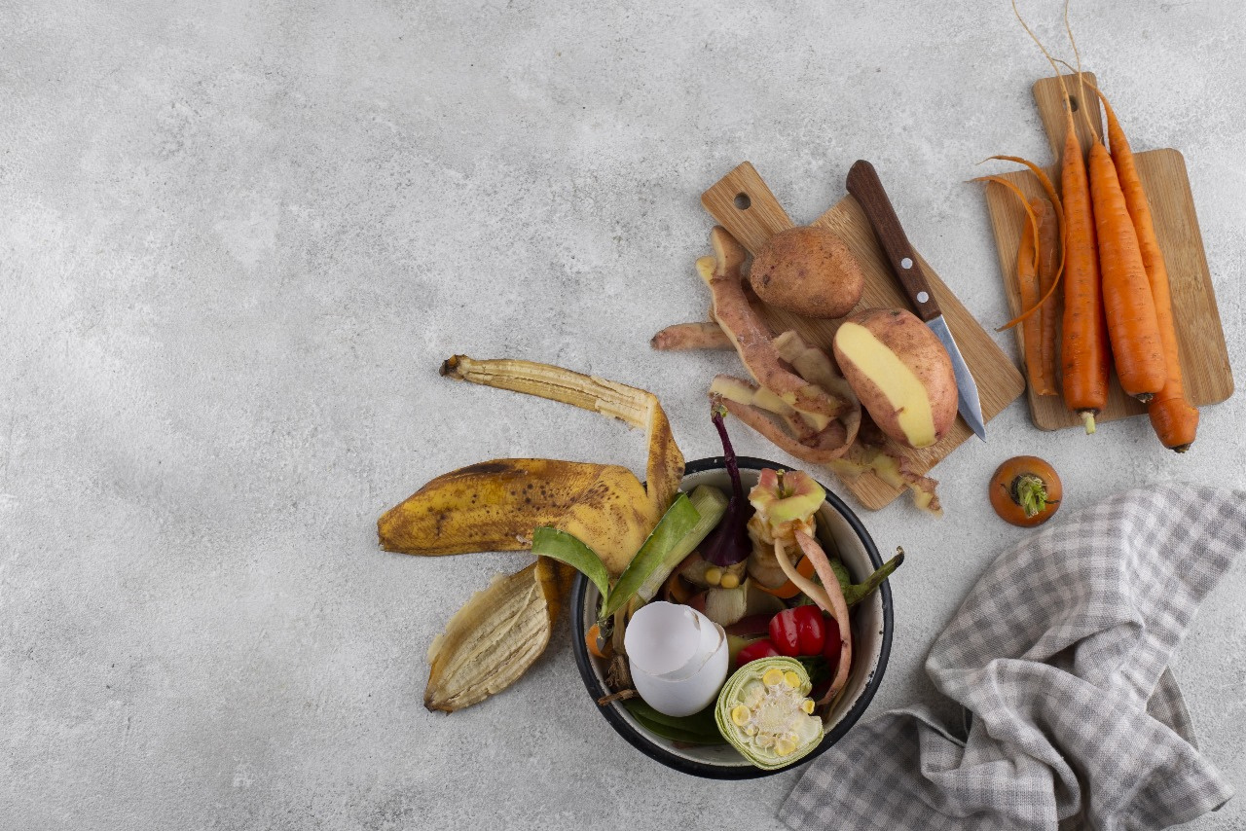
Ignis Code
▪ 2.24 billion tons of waste produced annually
▪ 91% of plastics are not recycled
▪ Landfills and incinerators contribute heavily to pollution
▪ Lack of sustainable and community-based waste solutions
▪ Problem Statement:
Current waste management systems are inefficient, centralized, and fail to unlock the value hidden in everyday trash.
The Waste Crisis: A Global Emergency

Slide 3

Ignis Code
Our Vision & Mission
Reimagining Waste, Empowering Tomorrow
▪ Our Vision: A sustainable world where trash is a valuable resource
▪ Our Mission: Build smart, scalable, and community-driven recycling ecosystems
Uniqueness:
▪Combines tech, community engagement, and circular design
Not just managing waste — we're transforming it

Slide 4


Ignis Code
How Greenify Works
Tech + Community + Reuse = Impact
Smart Collection — Eco-bins, app-linked pickup
AI Sorting — Efficient waste separation
Transformation — Energy, compost, and reusable goods
Reusability:
Products are designed to be used again and again
Organic waste is turned into compost
Plastics & metals are remanufactured into goods

Slide 5
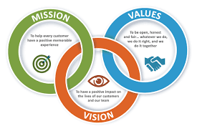
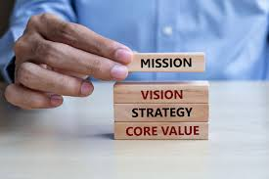
Ignis Code
Our Unique Value Proposition
Why Greenify is Different
AI-Driven Sorting = Higher efficiency
Community-Powered Ecosystem
Product Innovation (e.g., bricks from plastic waste)
Hyper-focus on Reusability, not just recycling
Uniqueness:
We don’t just recycle — we upcycle, regenerate, and innovate

Slide 6

Ignis Code
Scalability & Expansion
Built to Scale, Ready for Tomorrow
Modular systems work in urban & rural settings
Easily replicated in schools, cities, businesses
App allows for rapid onboarding of users & waste centers
Scalability:
Infrastructure-light model
Partnerships with local governments & NGOs
Global waste problem = Global opportunity

Slide 7
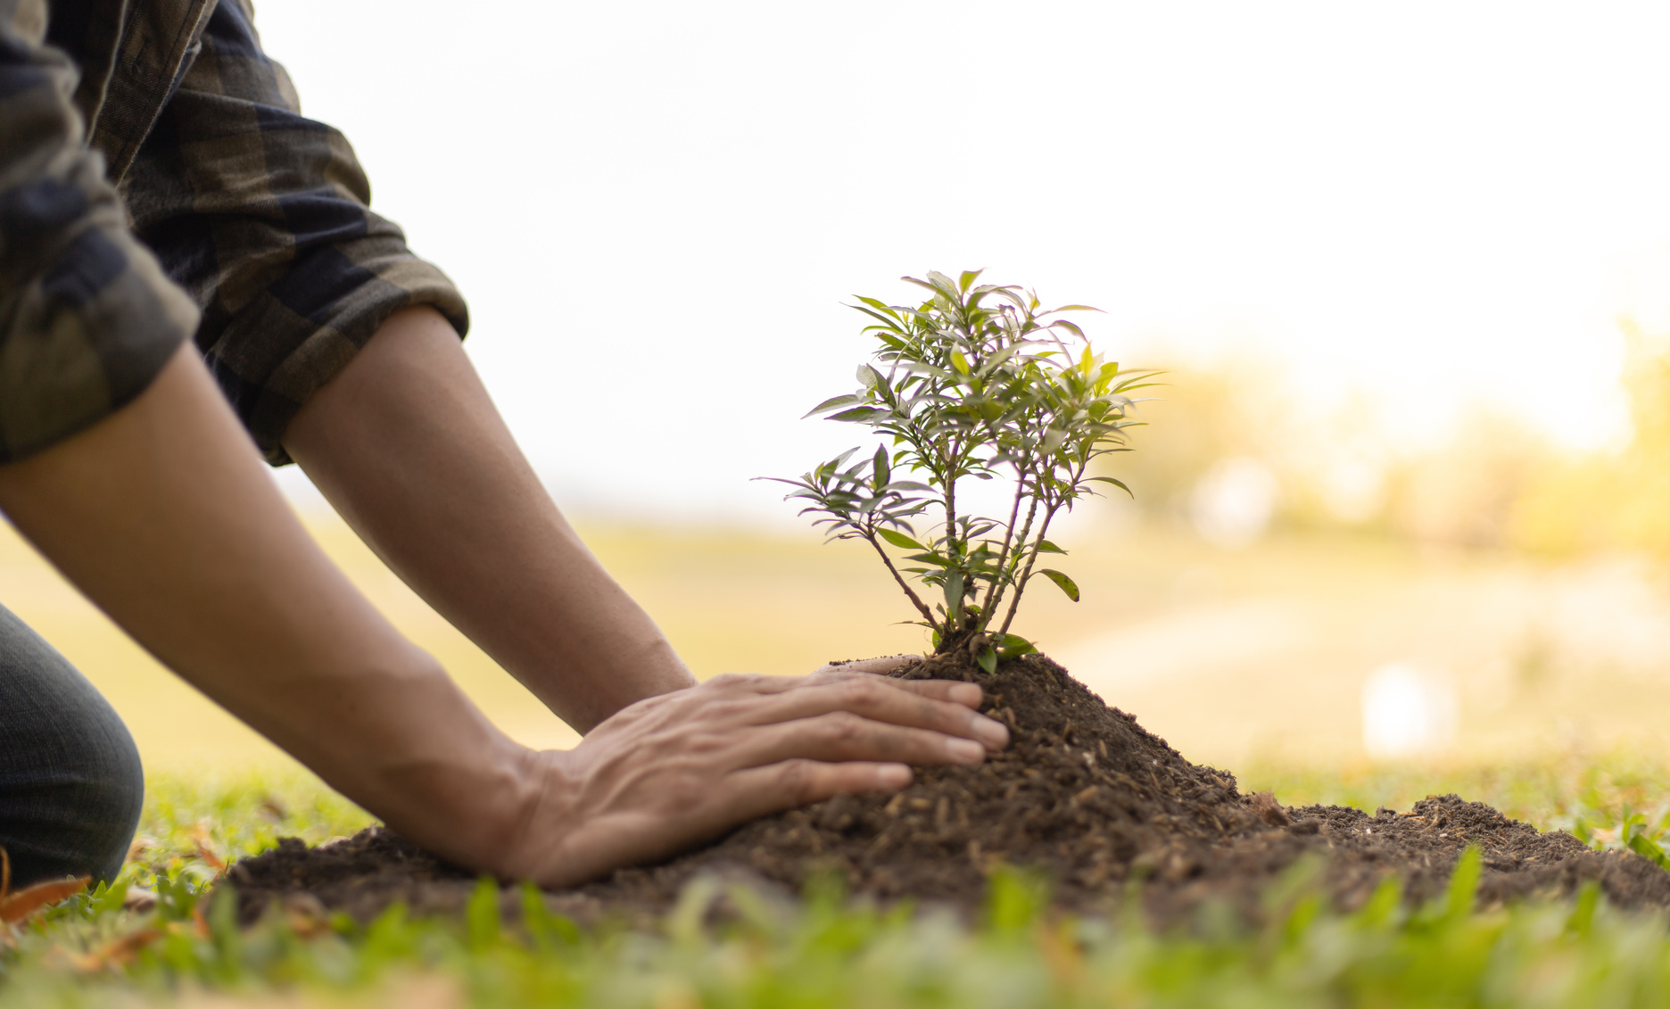

▪ Furniture from pallet wood
▪Bricks from plastic & ash
▪Organic compost for farmers
▪Bio-energy from organic waste
▪ Reusability at Core: Long-life cycle products
Designs that serve multiple uses
▪ Impact So Far:
120+ tons of waste reused
30% drop in local landfill contribution
1,000+ households actively recycling
Nature and Human Culture

Slide 8


ignis code
Join the Greenify Movement
Partner with us (schools, municipalities, startups)
Volunteer for community cleanups
Download our app to track your own waste impact
greenify.org | IG: @GreenifyTomorrow
Scalable & Replicable:
Works in any region with waste — that’s everywhere
Get Involved

Slide 9





Our Team
Ignis Code
Nishitha.T.S
TEAM LEADER
Dhanushri.G
Jeffry D’souza
Rakesh Readdy
Chinmy

Slide 10

Thank You
Ignis Code
Contact Us
+123-456-7890
greenify@gmail.com

